Slide 1

Algorithms and Data Structures 1 CS 0445
Fall 2023
Shell Sort and Merge Sort
Sherif Khattab
ksm73@pitt.edu
(Slides are adapted from Dr. Ramirez’s and Dr. Farnan’s CS 0445 slides.)

Slide 2
Announcements
Upcoming Deadlines:
Lab 5: Friday 11/10 @ 11:59 pm
Homework 9: Tuesday 11/14 @ 11:59 pm
Programming Assignment 4: Friday 11/17 @ 11:59 pm

Slide 3
Sorting Algorithms
Efficiency of sorting algorithm is significant
O(n²)
Bubble Sort
Selection Sort
Insertion Sort
Shell Sort
O(n log n)
Merge Sort
Quick Sort
O(n)
Radix Sort (doesn’t use data comparisons)

Slide 4
Sorting Algorithms: Plan
understand the main concept using an example
implement the algorithm
on an Array
iterative (illustrated using Bubble Sort)
recursive (illustrated using Selection Sort)
on a linked list
iterative (illustrated using Insertion Sort)
recursive
Analyze run-time and properties

Slide 5
Properties of Sorting Algorithms
In-place:
Only an O(1) extra space is needed
Sort doesn’t use any extra/temporary arrays
Stable:
Equal items in original array maintain their relative order in sorted array
e.g., original: 8, 9, 8, 7, 3, 7, 1, 9
sorted: 1, 3, 7, 7, 8, 8, 9, 9
Important when original array has been sorted using a different criterion
e.g., sort by grade then by name
Adaptive:
Performance changes based on how sorted original array is

Slide 6
Is Selection Sort stable?
Assume two arbitrary items i == j in original array
i before j
Assume two arbitrary items x < y < i in original array
y before x
x and y are after i and j
Original array: ….. i … j …… y ….. x …….
The following scenario is possible:
at some iteration, i is swapped with x
at a later iteration, j is swapped with y
….. x … y …… j ….. i …….
j becomes smallest item in unsorted subarray before i
So, j swapped back into sorted subarray in a position before i
Sorted array: ….. x … y …j i ……..…….

Slide 7
Can we make Selection Sort Stable?
Keep track of the original position of each item
in a separate helper array
update helper array with every swap
Use helper array to break ties in findSmallestItem
….. x … y …… j ….. i …….
i selected as smallest item before j

Slide 8
Properties of Selection Sort
Selection sort
in-place?
stable?
adaptive?
provides partial solution when interrupted during execution
Yes
No
No

Slide 9
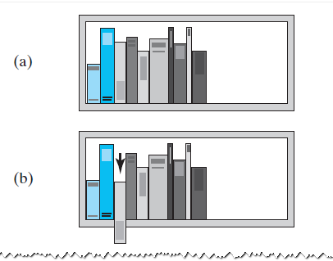
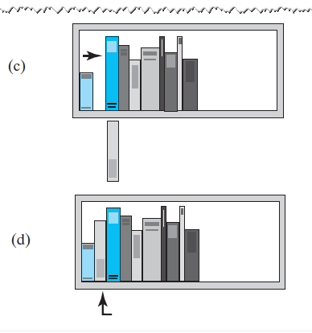
Insertion Sort
Basic Idea: In iteration i, insert item at position i into sorted sublist (0, i-1)
iteration 2:

Slide 10
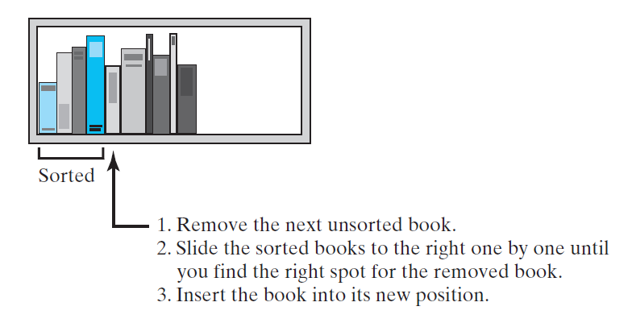
Insertion Sort
iteration 4:

Slide 11
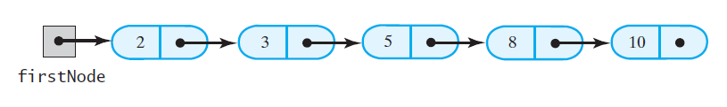
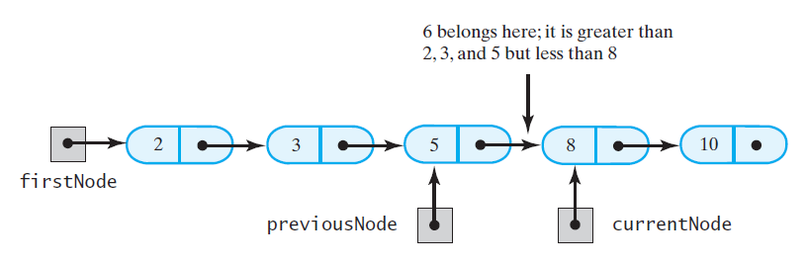
Insertion Sort of an LList
A chain of integers sorted into ascending order
Insert: 6
1. traverse chain to locate insertion point
2. save a reference to the node before current

Slide 12
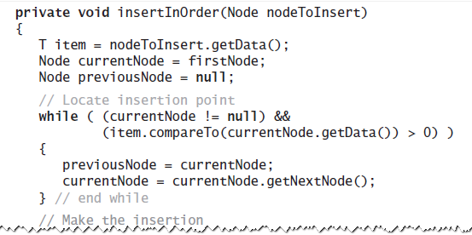
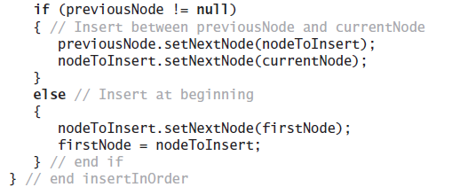
Inserting into a sorted sublist

Slide 13
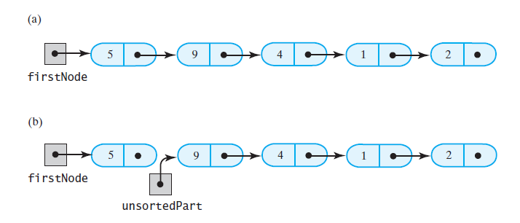
Breaking a chain of nodes into two pieces
First step of insertion sort

Slide 14
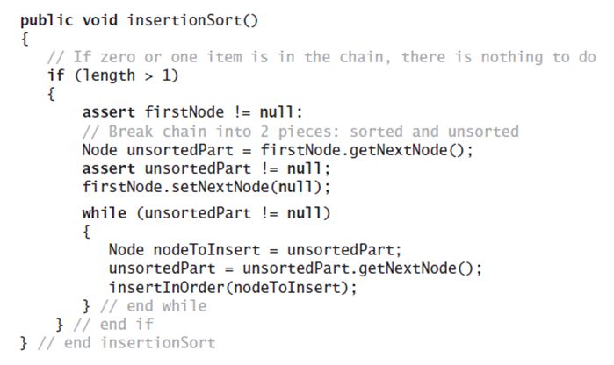
Insertion Sort of a Chain of Linked Nodes
Node firstNode)

Slide 15
Is Insertion Sort stable?
Assume two arbitrary items i == j in original array
i before j
Original array: ….. i … j ………….
Insertion Sort iterates over array left to right
will insert i into sorted subarray before j
….. i … …… j ……….
When j gets inserted later, loop inside insertInOrder will stop right after item i
j will be inserted after i
….. i j… …………….

Slide 16
Properties of Insertion Sort
Insertion sort
in-place?
stable?
adaptive?
small constant factors
very fast on small inputs
Yes
Yes
Yes

Slide 17
Runtime Analysis of Insertion Sort
O(n²) comparisons and swaps in the worst-case
O(n) in the best case

Slide 18
Shell Sort
Improved insertion sort developed by Donald Shell
limitation of Insertion Sort:
an item far from its sorted position → many comparisons and swaps to put it in sorted position
basic idea of Shell Sort: move items closer to sorted positions faster
How?
Sort subarrays of entries x positions apart
x goes from n/2 down to 1
When x == 1 → same as Insertion Sort
but items have been moved closer to sorted positions

Slide 19
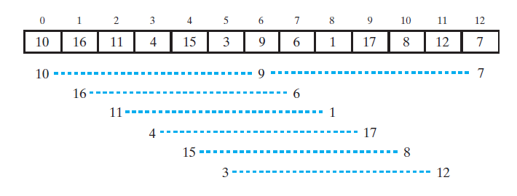
Shell Sort
subarrays of entries 6=n/2 positions apart
6 subarrays that are 6 positions apart

Slide 20
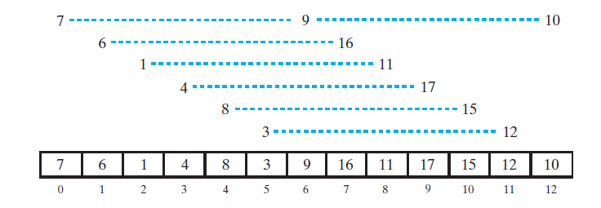
Shell Sort
The subarrays after each is sorted

Slide 21
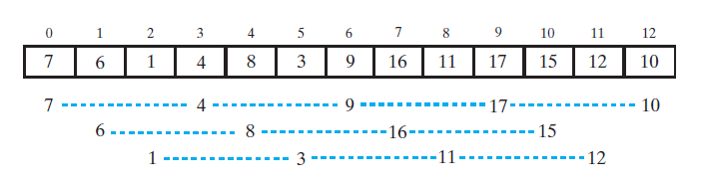
Shell Sort
3 subarrays of entries 3=n/4 positions apart

Slide 22
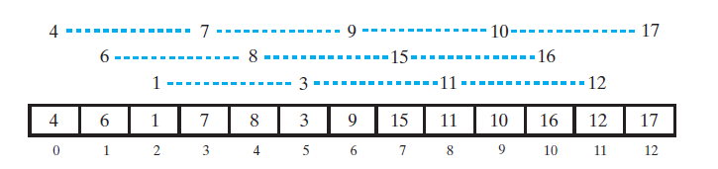
Shell Sort
The subarrays after each is sorted

Slide 23
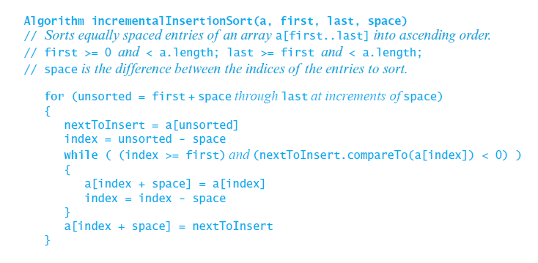
Shell Sort
Modify Insertion Sort to work on subarrays of entries separated separated by an increment of space.

Slide 24
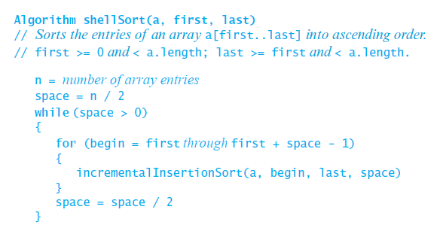
Shell Sort
Shell Sort invokes incrementalInsertionSort with a sequence of spacing factors
Sort all subarrays with
space positions apart

Slide 25

Efficiency of Shell Sort
Efficiency highly depends on the spacing sequence
Average case O(n $\sqrt{n}$ = n^{1.5})
Best case (when input almost sorted)
O(n) when number of space values independent of n
O(n log n) when space is divided by 2 in each iteration

Slide 26
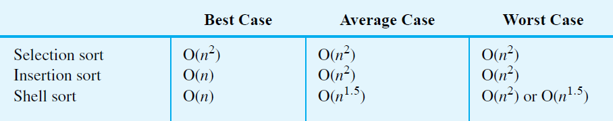
Comparing the Algorithms

Slide 27
Merge Sort
basic idea: divide array into halves, sort the halves, and merge sorted halves
Major programming effort is in the merge process

Slide 28
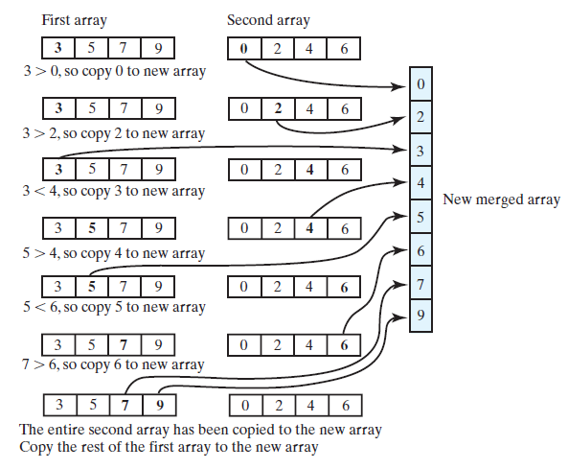
Merging Arrays
Merging two sorted arrays into one sorted array

Slide 29
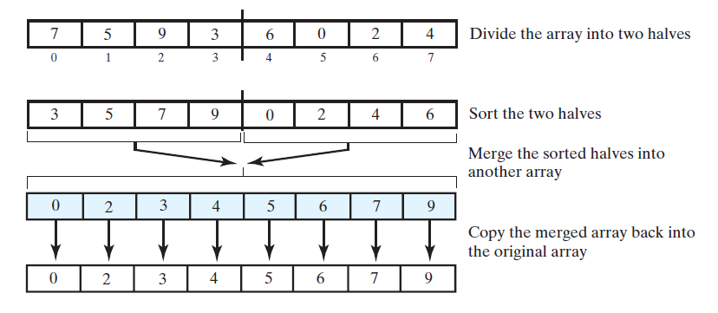
Recursive Merge Sort

Slide 30
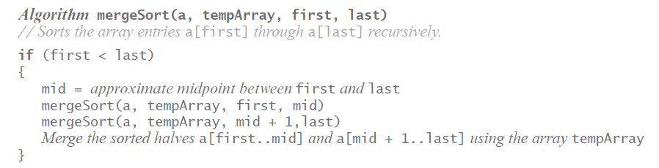
Recursive Merge Sort

Slide 31
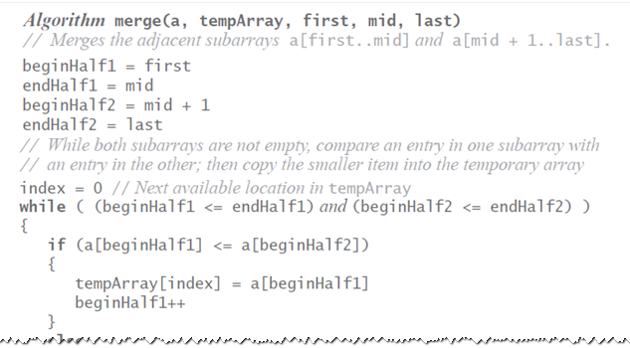
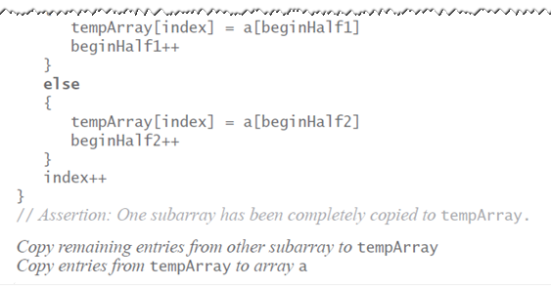
Merge

Slide 32
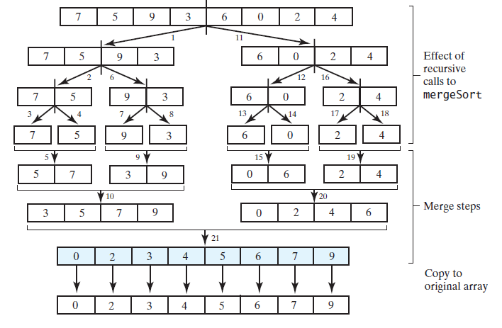
Recursion Tree

Slide 33
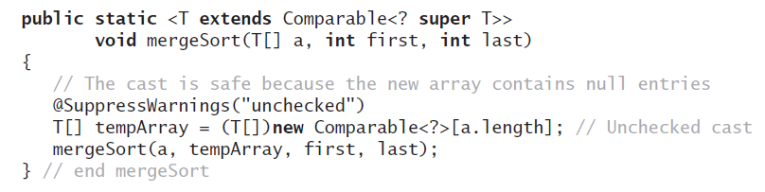
Allocate temporary array only once

